Slide 1

Deep learning I
Mitko Veta M.Veta@tue.nl
Image from xkcd.com

Slide 2
Outline of today’s lecture:
1. Logistic regression (recap)
2. Neural networks
3. Convolutional neural networks
4. Backpropagation
5. Training deep neural networks
6. The U-Net architecture
7. Deep learning with Keras

Slide 3
Materials:
Chapters II.6– II.10 from Goodfellow et al. Deep learning
Cireşan et al. "Mitosis detection in breast cancer histology images with deep neural networks." MICCAI, 2013.
Ronneberger et al. "U-net: Convolutional networks for biomedical image segmentation." MICCAI, 2015
Meijering et al. “A bird’s-eye view of deep learning in bioimage analysis” CSBJ, 2020

Slide 4
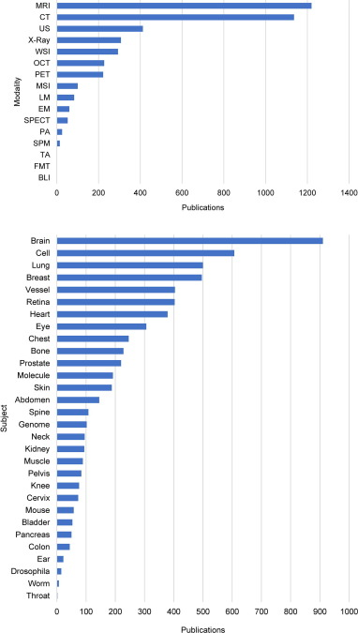
Number of peer-reviewed journal and selected conference proceedings publications on deep learning in different biomedical application areas, categorized by imaging modality (top, see text for abbreviations) and subject of study (bottom), ranked from most to least popular.
Meijering et al. “A bird’s-eye view of deep learning in bioimage analysis” CSBJ, 2020

Slide 5
Logistic regression
… which is actually a classification method

Slide 6
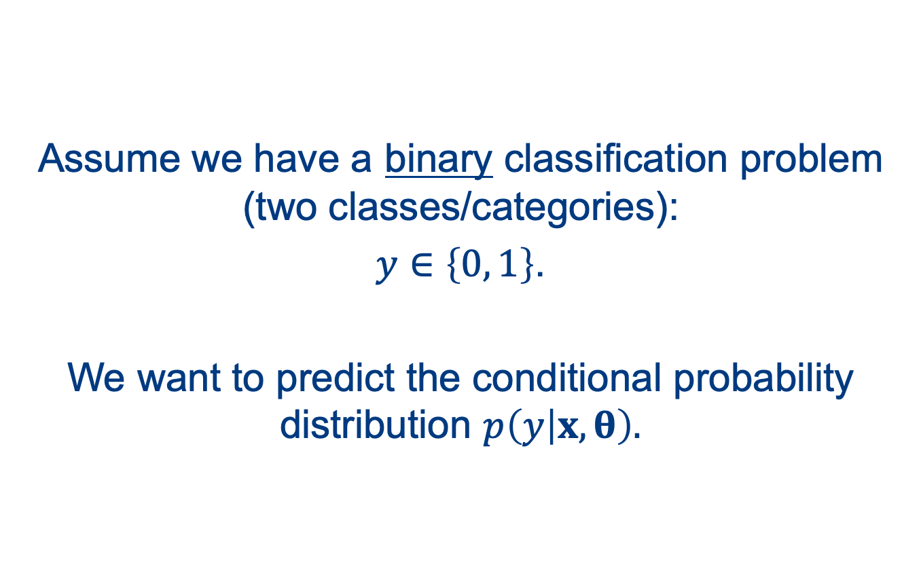
Assume we have a binary classification problem (two classes/categories):
$y∈\left\{0, 1\right\}$.
We want to predict the conditional probability distribution $p\left(y | x,θ\right).$

Slide 7
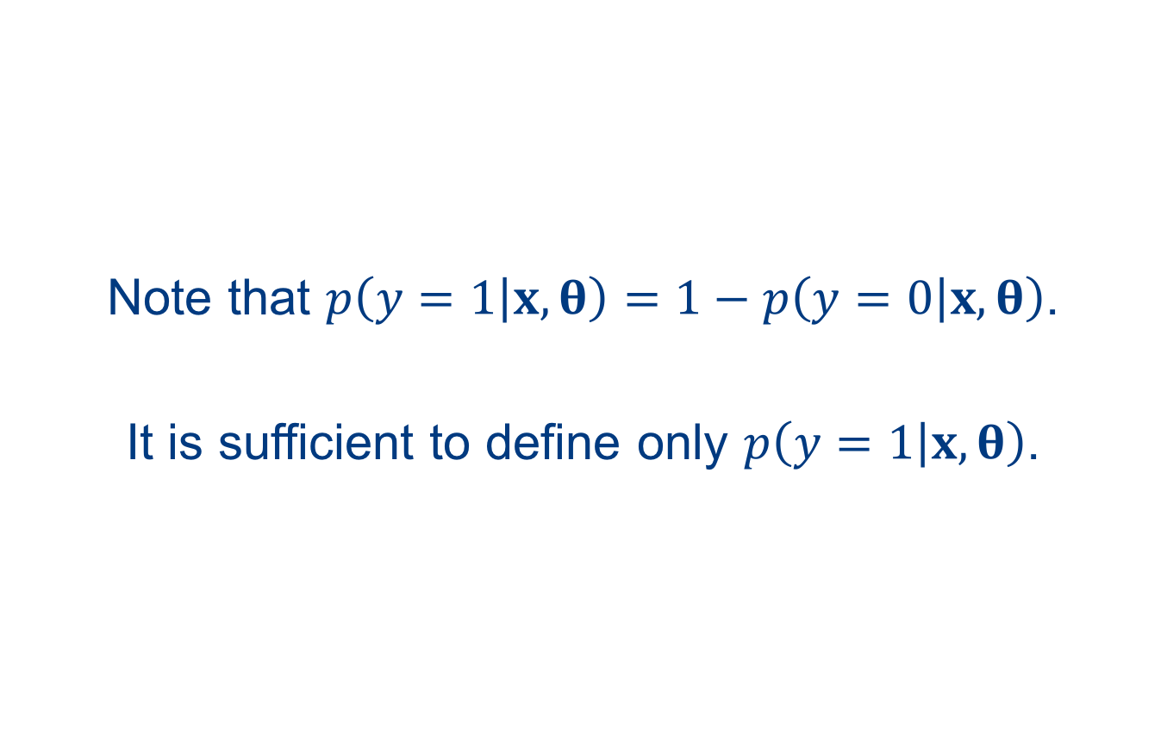
Note that $p\left(y=1 | x,θ\right)=1−p\left(y=0 | x,θ\right)$.
It is sufficient to define only $p\left(y=1 | x,θ\right)$.

Slide 8
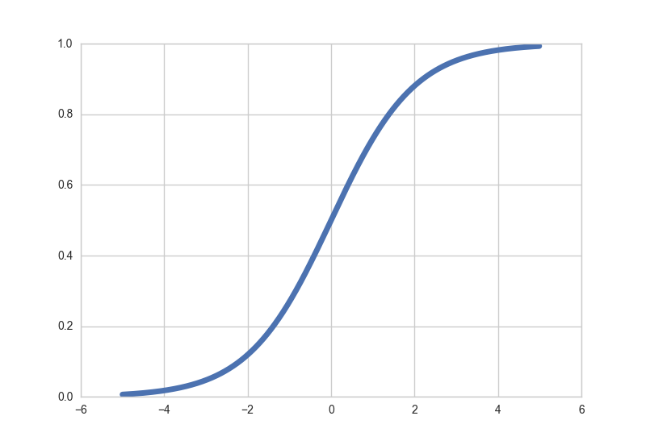
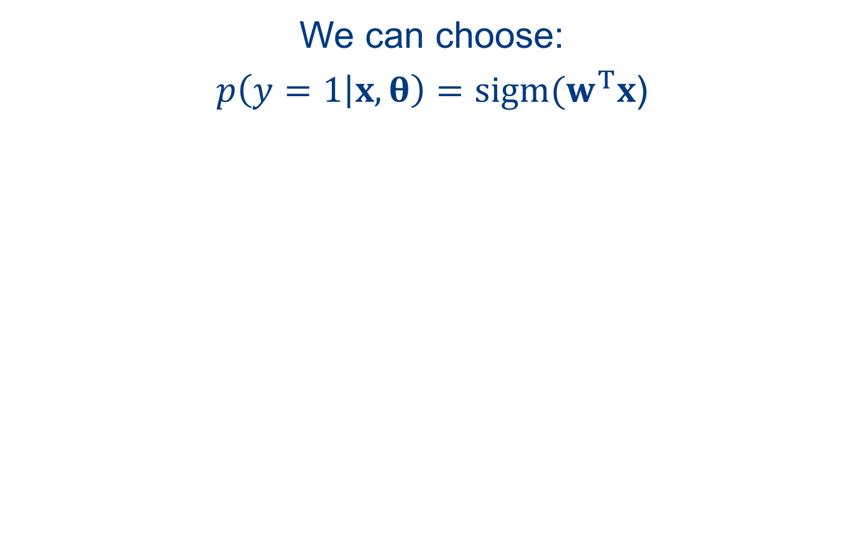


We can choose:
$p\left(y=1 | x,θ\right)=sigm(w^{T}x$)
$$p\left(y=1 | x,θ\right)$$
“squashing effect”
$$w^{T}x$$

Slide 9
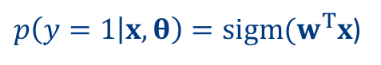
The parameters w can be determined by maximizing the log-likelihood.
$p\left(y=1 | x,θ\right)=sigm(w^{T}x$)
$$θ_{ML}={arg max}_{θ}\sum_{i=1}^{m}{log\left[{p\left(y=1 | x^{(i)},θ\right)}^{y^{(i)}}{p\left(y=0 | x^{(i)},θ\right)}^{{1−y}^{(i)}}\right]}$$
$$θ_{ML}={arg max}_{θ}\sum_{i=1}^{m}{log\left[{p\left(y=1 | x^{(i)},θ\right)}^{y^{(i)}}{\left[1−p\left(y=1 | x^{\left(i\right)},θ\right)\right]}^{y^{(i)}−1}\right]}$$

Slide 10
Compared to linear regression, there is no closed-form solution for the parameters of logistic regression.
The optimal parameters are found with gradient based optimization.
It is more common to minimize the negative log-likelihood.

Slide 11
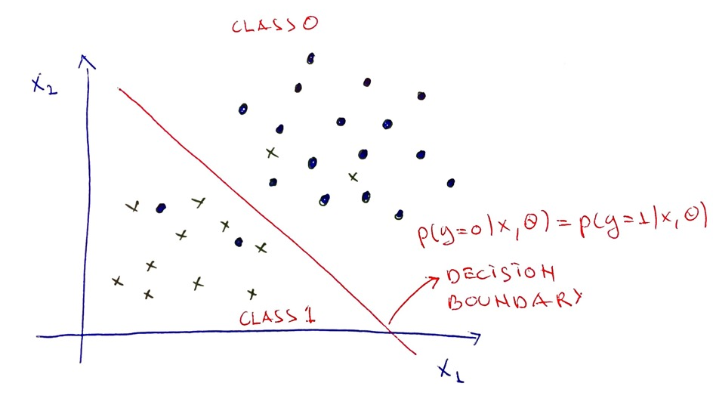
Logistic regression is a linear classifier.

Slide 12
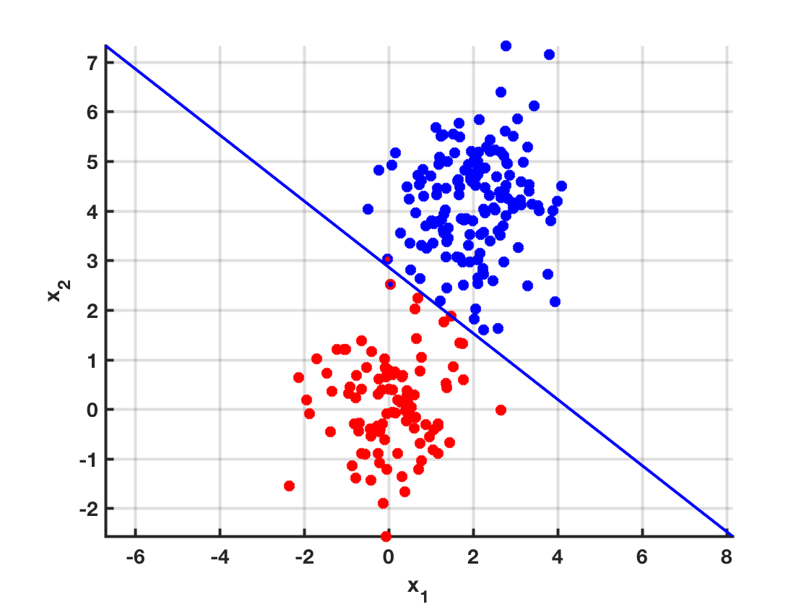
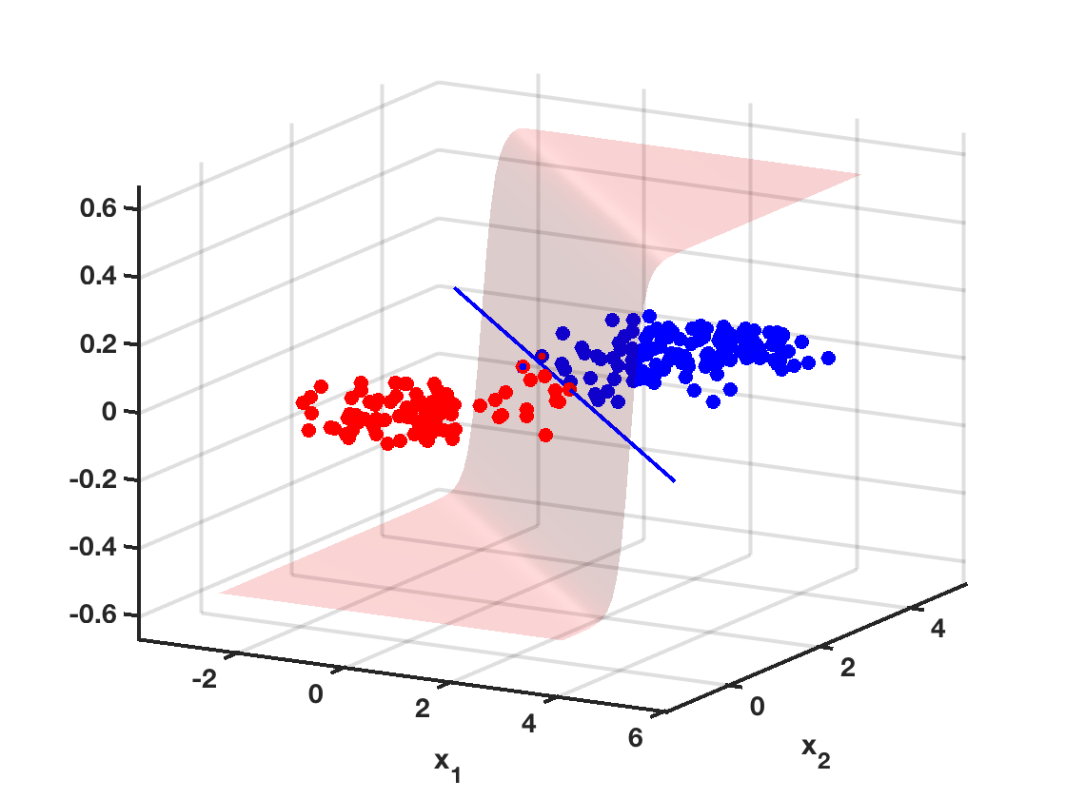
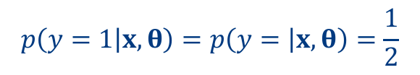
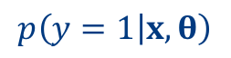
Logistic regression is a linear classifier.
$$p\left(y=1 | x,θ\right)=p\left(y= | x,θ\right)=\frac{1}{2}$$
$$p\left(y=1 | x,θ\right)$$

Slide 13
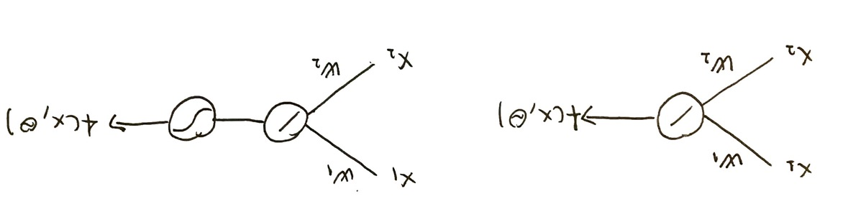
Logistic regression can be viewed as:
linear regression + sigmoid function
Looks a lot like a neuron!

Slide 14
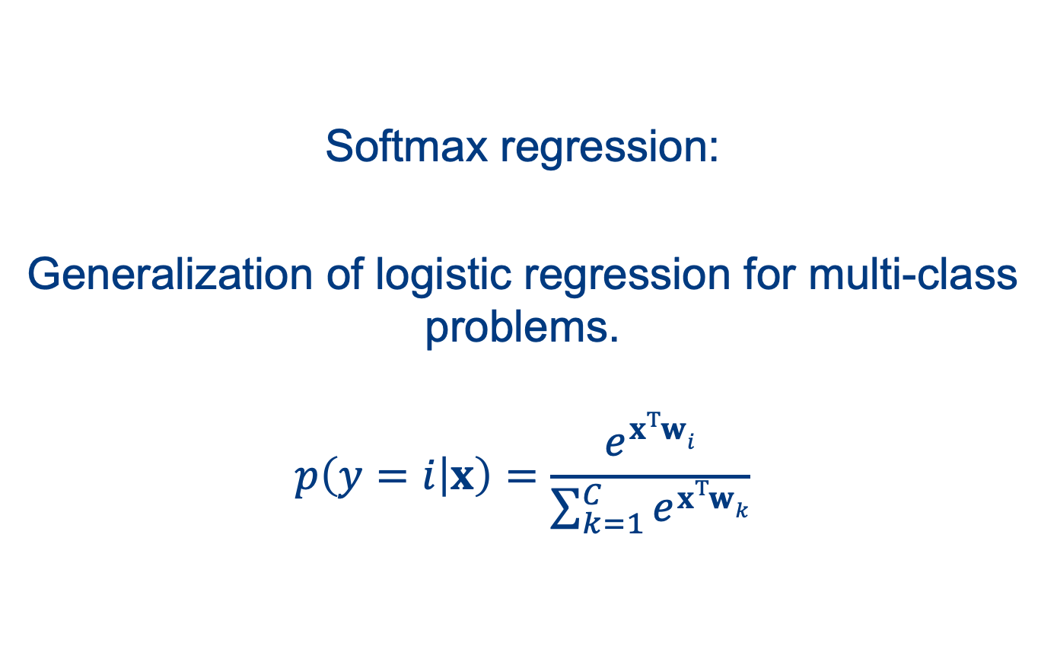
Softmax regression:
Generalization of logistic regression for multi-class problems.
$$p\left(y=i | x\right)=\frac{e^{xTwi}}{\sum_{k=1}^{C}{e^{xTwk}}}$$

Slide 15
Neural networks
When logistic regression is not enough

Slide 16
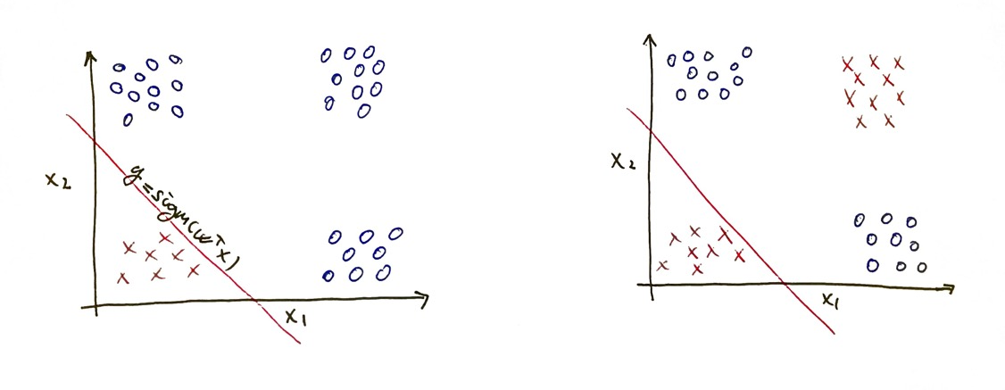
Consider these two classification problems:

Slide 17
The problem on the right can be solved by combining two linear classifiers:

Slide 18
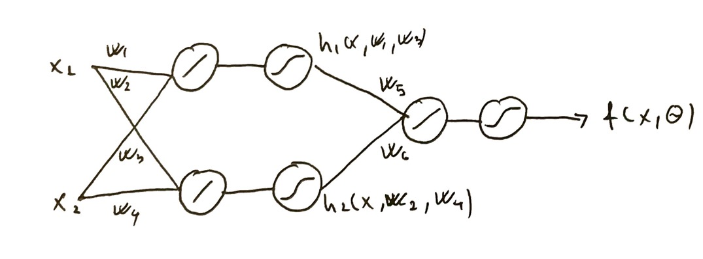
The problem on the right can be solved by combining two linear classifiers:
This is (a very small) feedforward neural network.
first LR:
one “to rule them”
second LR:

Slide 19
In “modern” neural networks, the the sigmoid nonlinearity in the hidden units is replaced with ReLU: f(a) = max(0, a)

Slide 20
Feedforward – because the information flows in one direction (there is not feedback).
Neural – because it loosely resembles concepts in neuroscience (biological neurons).
Network – because it is a composition of many elements.

Slide 21
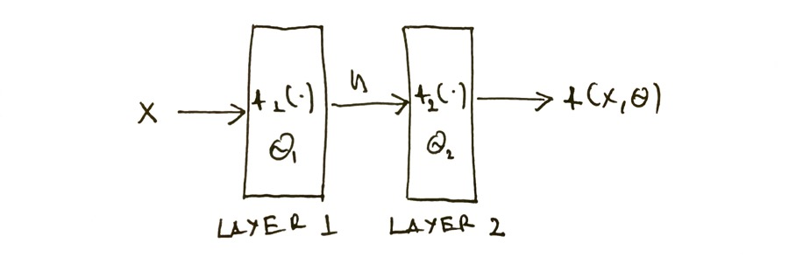
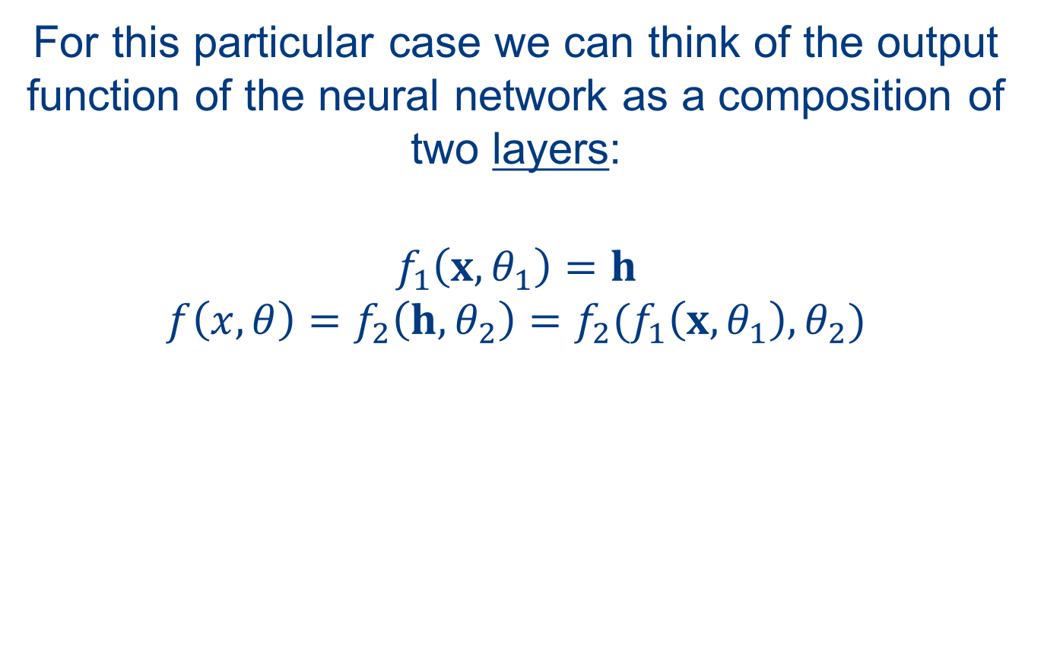
For this particular case we can think of the output function of the neural network as a composition of two layers:
$$f_{1}\left(x,θ_{1}\right)=h$$
$$f\left(x,θ\right)=f_{2}\left(h,θ_{2}\right)=f_{2}(f_{1}\left(x,θ_{1}\right),θ_{2})$$

Slide 22
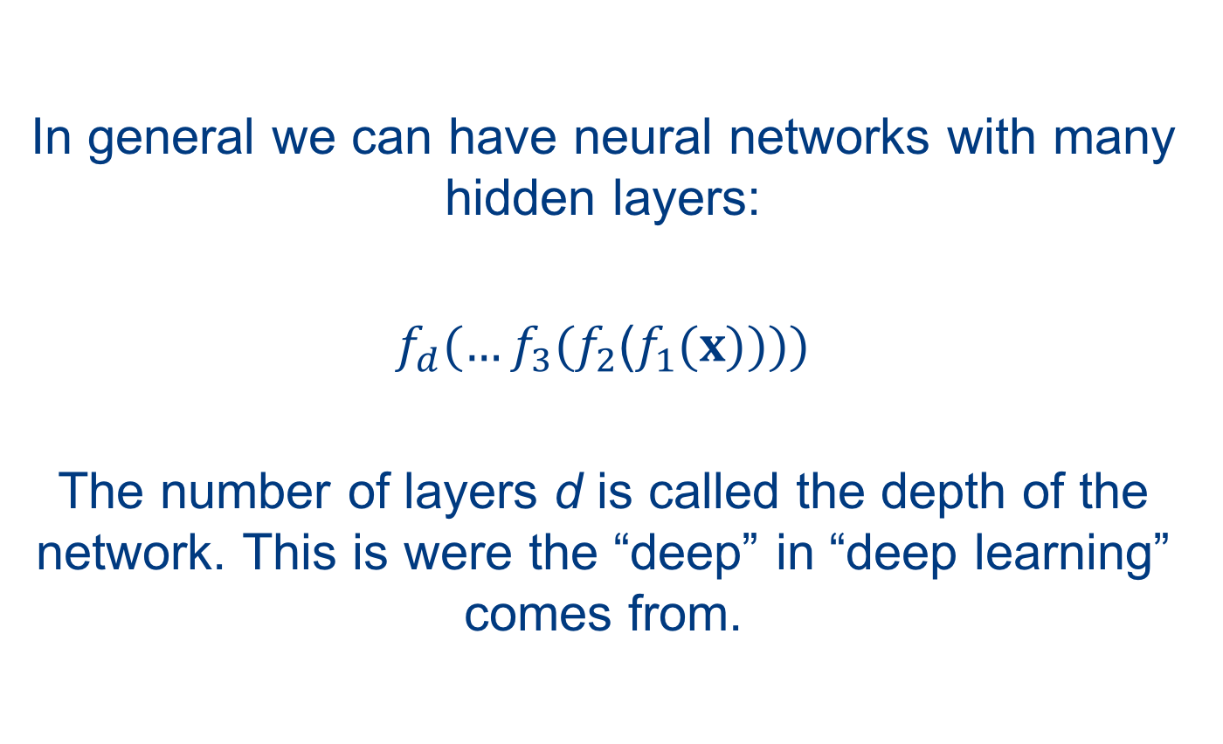
In general we can have neural networks with many hidden layers:
$f_{d}(…f_{3}(f_{2}$($f_{1}(x))))$
The number of layers d is called the depth of the network. This is were the “deep” in “deep learning” comes from.

Slide 23
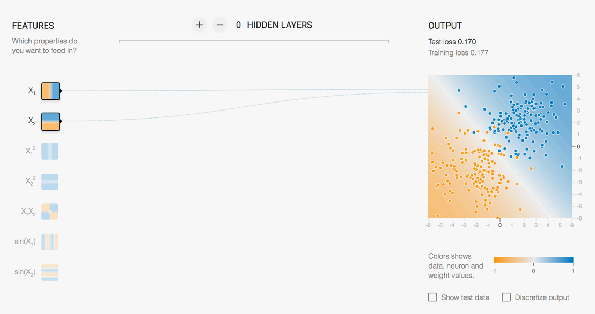
Examples in Tensorflow playground.
playground.tensorflow.org

Slide 24
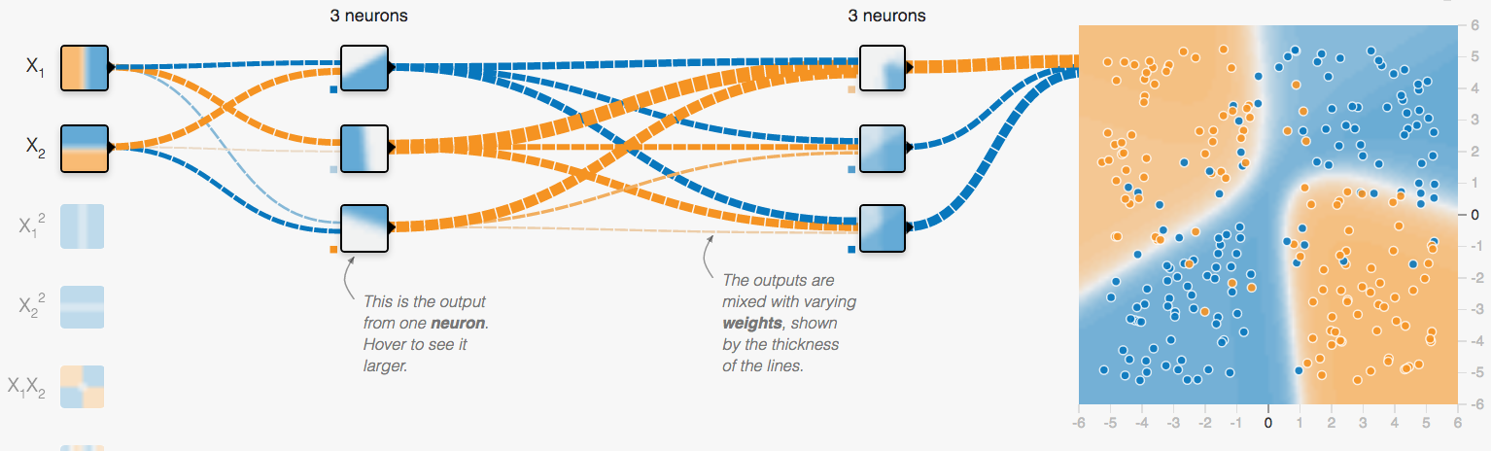
Deep neural networks
It is highly recommended to play around in Tensorflow Playground to develop some intuition about training neural networks for different classification problems.
Experiment with different problems, network depths and number of neurons, different activation functions, the regularization parameter (L₂ regularization) etc.
playground.tensorflow.com

Slide 25
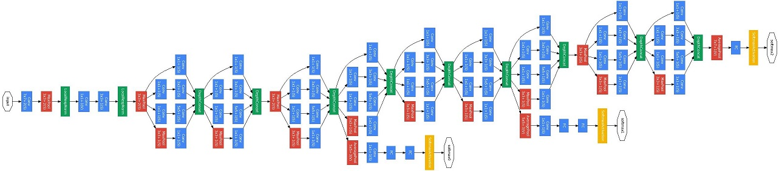
Deep learning frameworks implement layers as the basic building blocks of neural networks.
GoogLeNet
Figure from Szegedy et al. CVPR 2015

Slide 26
Every layer has an input tensor, and output tensor and (optionally) parameters.
Data input and output are also layers.
nn = keras.models.Sequential() nn.add(keras.layers.Dense(100, activation=‘sigmoid’))
nn.add(keras.layers.Dense(10, activation=’softmax'))

Slide 27
Convolutional neural networks

Slide 28
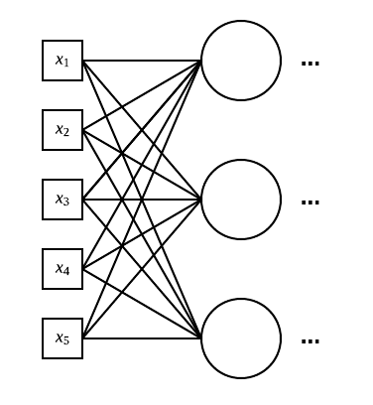
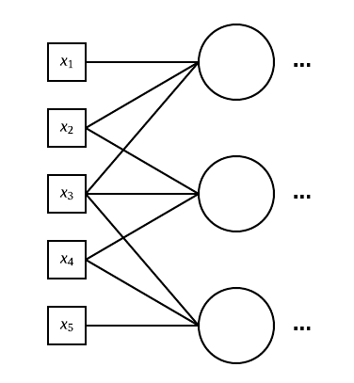
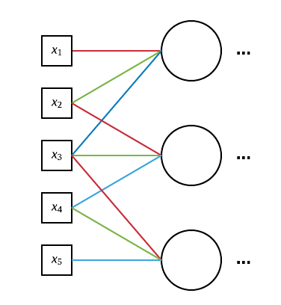
How many weights?
receptive field
sparsely
connected NN
9 weights
“regular” NN
15 weights
shared weights
3 weights

Slide 29
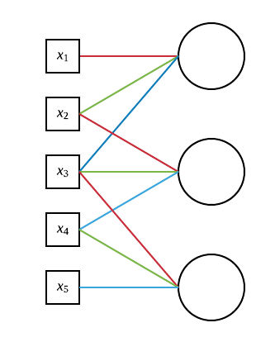
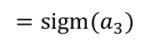
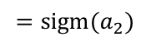
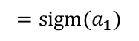
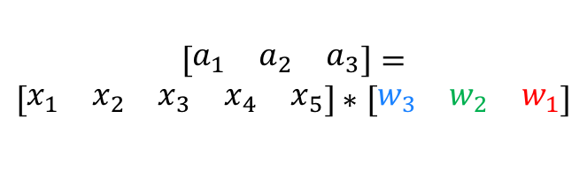
How many weights?
$${=sigm(a}_{1})$$
$$a_{1}=x_{1}w_{1}+x_{2}w_{2}+x_{3}w_{3}$$
$$a_{2}=x_{2}w_{1}+x_{3}w_{2}+x_{4}w_{3}$$
$$a_{2}=x_{3}w_{1}+x_{4}w_{2}+x_{5}w_{3}$$
$${=sigm(a}_{2})$$
$$\left[\begin{matrix}a_{1} & a_{2} & a_{3}\end{matrix}\right]=$$
$$\left[\begin{matrix}x_{1} & x_{2} & x_{3} & x_{4} & x_{5}\end{matrix}\right]∗\left[\begin{matrix}w_{3} & w_{2} & w_{1}\end{matrix}\right]$$
$${=sigm(a}_{3})$$
shared weights
3 weights
convolution, thus convolutional NN

Slide 30
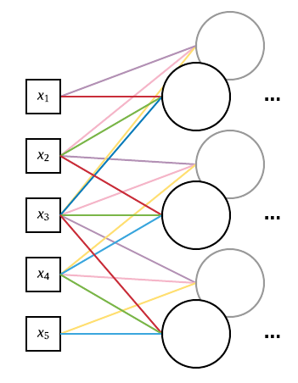
How many weights?
Note that the added neurons are not a new layer. They are part of layer 1.
shared weights
3 weights
two sets shared weights
6 weights

Slide 31
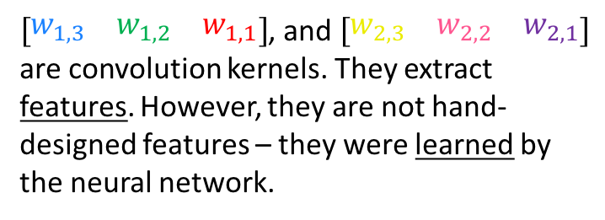
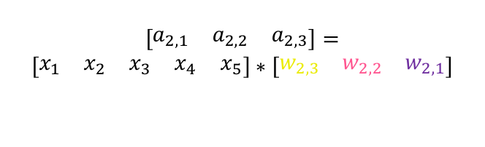
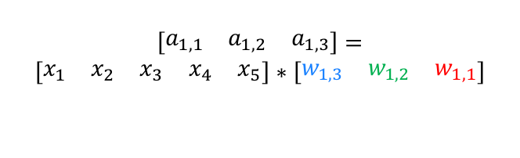
Convolutional neural networks
$$\left[\begin{matrix}a_{1,1} & a_{1,2} & a_{1,3}\end{matrix}\right]=$$
$$\left[\begin{matrix}x_{1} & x_{2} & x_{3} & x_{4} & x_{5}\end{matrix}\right]∗\left[\begin{matrix}w_{1,3} & w_{1,2} & w_{1,1}\end{matrix}\right]$$
$$\left[\begin{matrix}a_{2,1} & a_{2,2} & a_{2,3}\end{matrix}\right]=$$
$$\left[\begin{matrix}x_{1} & x_{2} & x_{3} & x_{4} & x_{5}\end{matrix}\right]∗\left[\begin{matrix}w_{2,3} & w_{2,2} & w_{2,1}\end{matrix}\right]$$
$\left[\begin{matrix}w_{1,3} & w_{1,2} & w_{1,1}\end{matrix}\right]$, and $\left[\begin{matrix}w_{2,3} & w_{2,2} & w_{2,1}\end{matrix}\right]$ are convolution kernels. They extract features. However, they are not hand-designed features – they were learned by the neural network.
two sets shared weights
6 weights

Slide 32

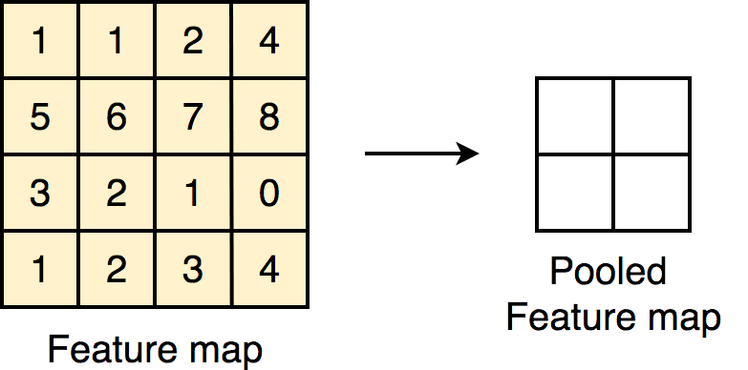
Convolutional neural networks
Figures from https://github.com/vdumoulin/conv_arithmetic, https://towardsdatascience.com/@aryanmisra

Slide 33
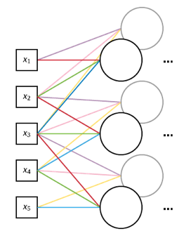
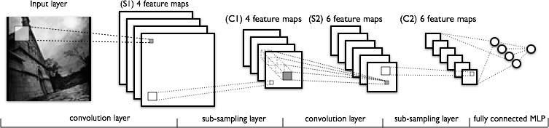
Convolutional neural networks
1D NN
2D NN (images)
Because of the weight sharing, convolutional neural networks only make sense for signals (such as images) as inputs.
Image from deeplearning.net

Slide 34
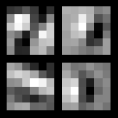
Convolutional kernels:
these are the weights
(convolution kernels)
that produce the four
feature maps
Image from deeplearning.net

Slide 35
output_size = (input_size – kernel_size + 2*padding)/stride + 1
output_size – spatial extent of the input feature maps
input_size – spatial extent of the output feature maps
kernel_zie – spatial extent of the kernel
padding – padding of the input image/feature maps
stride – “step” for applying the convolution
Note that for 2×2 max pooling: kernel_size = 2, stride = 2.

Slide 36
Training deep neural networks
Mitko Veta M.Veta@tue.nl

Slide 37

Image from volkskrant.nl

Slide 38
Gradient descent

Slide 39
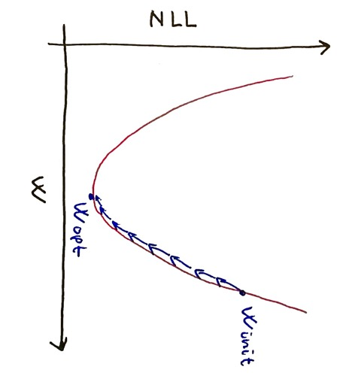
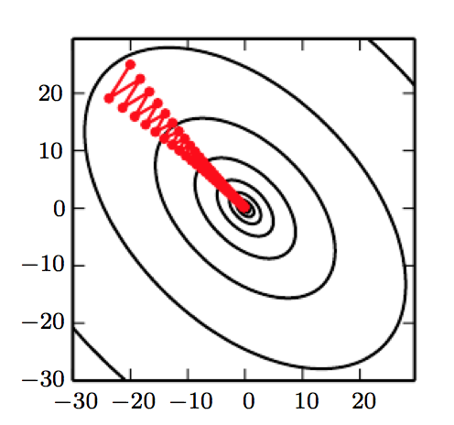
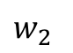
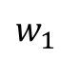
Gradient descent
$$w_{2}$$
$$w_{1}$$
Figure from deeplearningbook.org

Slide 40
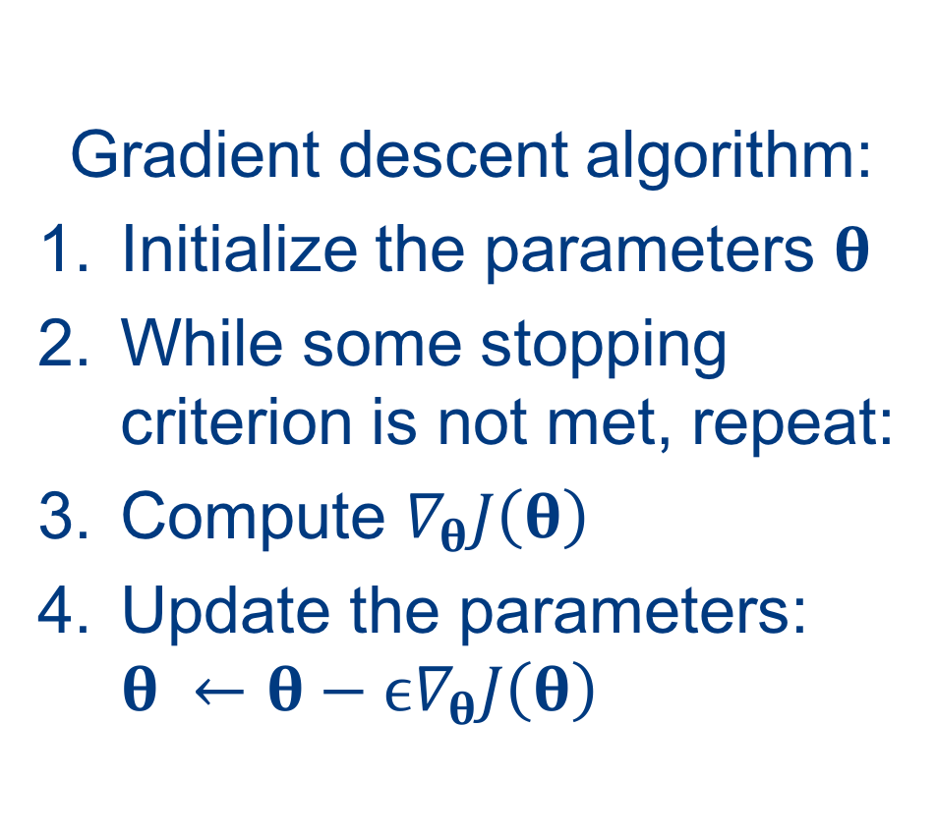
Gradient descent algorithm:
Initialize the parameters 𝛉
While some stopping criterion is not met, repeat:
Compute $∇_{θ}J\left(θ\right)$
Update the parameters: ${θ ←θ−ϵ∇}_{θ}J\left(θ\right)$
$$w_{2}$$
$$w_{1}$$
Figure from deeplearningbook.org

Slide 41
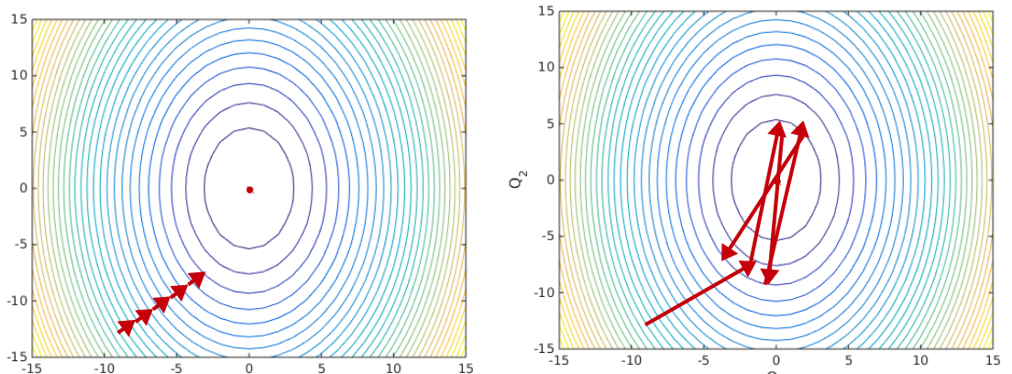
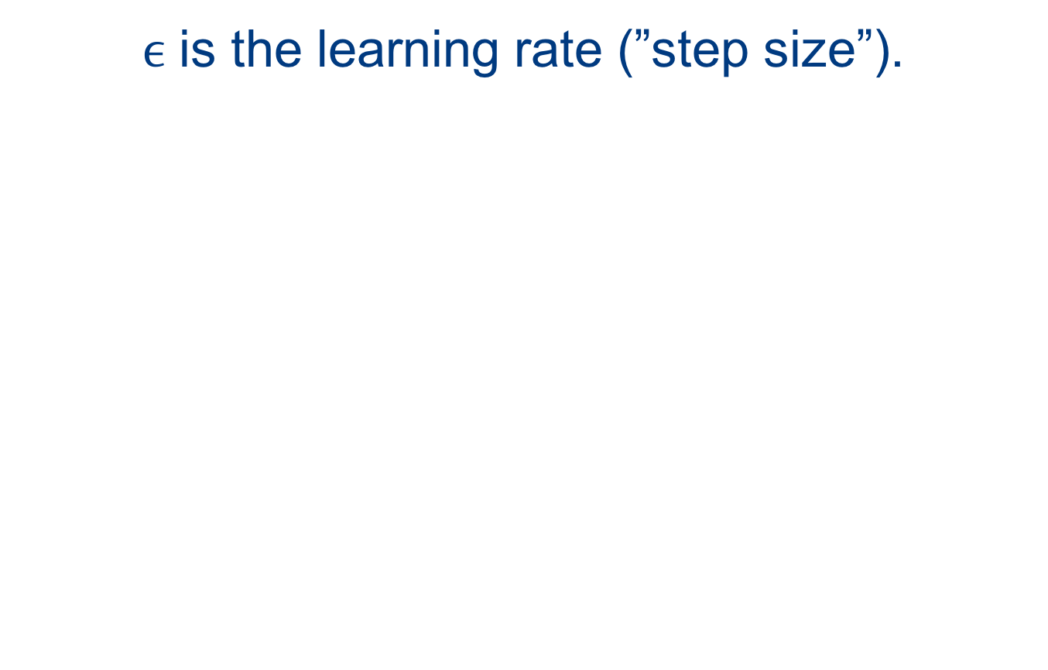
$ϵ$ is the learning rate (”step size”).
Too low.
Too high.

Slide 42
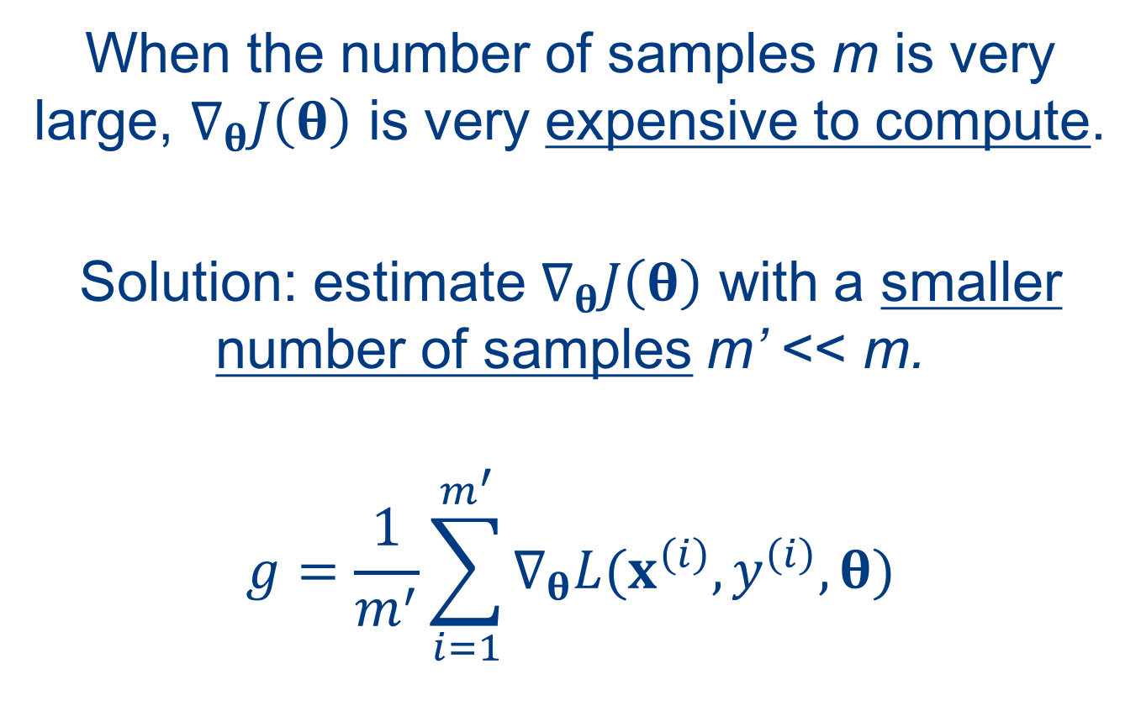
When the number of samples m is very large, $∇_{θ}J\left(θ\right)$ is very expensive to compute.
Solution: estimate $∇_{θ}J\left(θ\right)$ with a smaller number of samples m’ << m.
$$g=\frac{1}{m^{′}}\sum_{i=1}^{m^{′}}{∇_{θ}L(x^{\left(i\right)},y^{\left(i\right)},θ)}$$

Slide 43
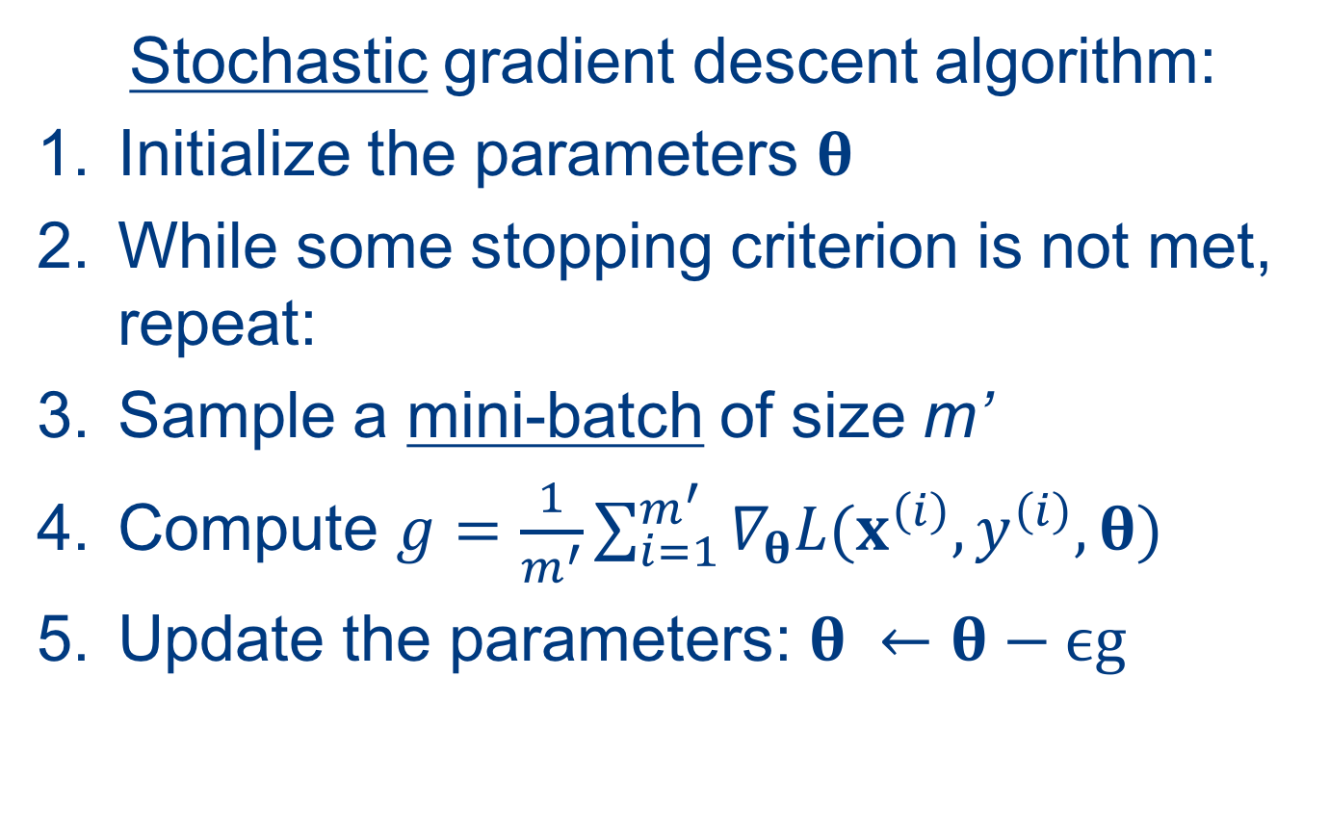
Stochastic gradient descent algorithm:
Initialize the parameters 𝛉
While some stopping criterion is not met, repeat:
Sample a mini-batch of size m’
Compute $g=\frac{1}{m^{′}}\sum_{i=1}^{m^{′}}{∇_{θ}L(x^{\left(i\right)},y^{\left(i\right)},θ)}$
Update the parameters: $θ ←θ−ϵg$

Slide 44
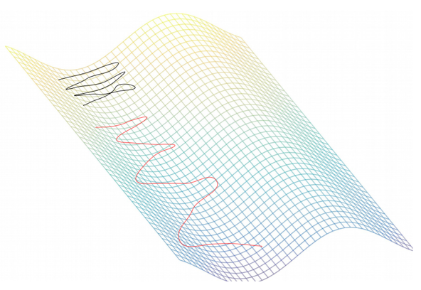
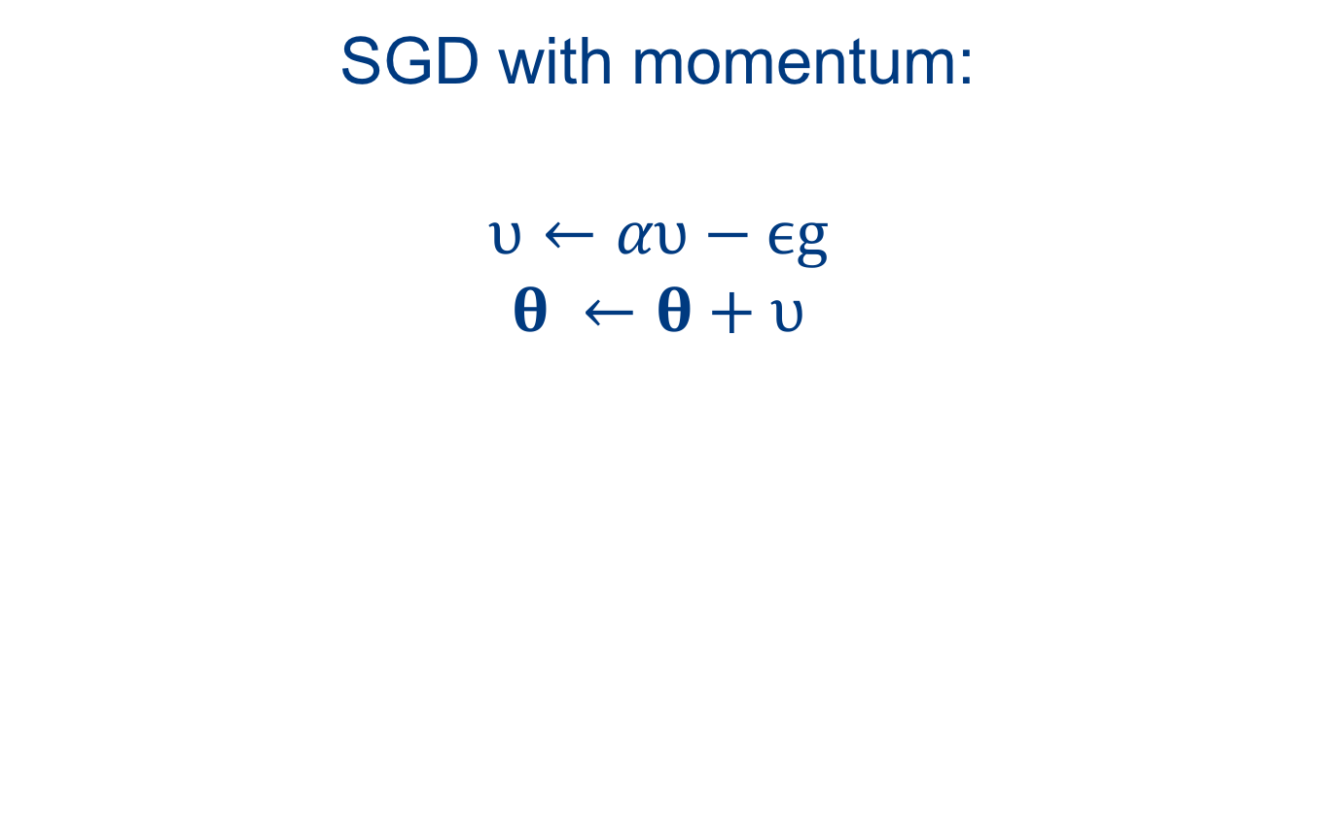
SGD with momentum:
$$υ←αυ−ϵg$$
$$θ ←θ+υ$$
without momentum
with momentum

Slide 45
Other algorithms:
Nesterov momentum
Adaptive learning rates: Adam, AdaGrad, RMSProp
Approximate second-order methods

Slide 46
Back-propagation

Slide 47

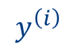
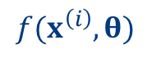

Loss layer
$$L(x^{\left(i\right)},y^{\left(i\right)},θ)$$
$$x^{\left(i\right)}$$
$$f(x^{\left(i\right)},θ)$$
$$y^{\left(i\right)}$$
Image from deeplearning.net

Slide 48

Even for a small neural network, computing the derivative w.r.t. every parameter involves evaluation of “lengthy” mathematical expressions

Slide 49
For very deep networks, the straightforward approach becomes prohibitively expensive.
We need a “smarter” way of computing the gradient w.r.t. every parameter.
This “smarter” algorithm is called back-propagation. It is just the chain rule of differentiation applied to neural network layers.

Slide 50






Chain rule of differentiation:
$z=f\left(y\right)$
$$y=g\left(x\right)$$
$$z=f\left(g\left(x\right)\right)$$
$$\frac{dz}{dx}=\frac{dz}{dy}\frac{dy}{dx}$$
$$y$$
$$x$$
$$g(∙)$$
$$f(∙)$$
$$z$$

Slide 51


$$J\left(θ\right)=f^{\left(L\right)}\left(h^{\left(L\right)}\right)$$
$$h^{\left(L\right)}=f^{\left(L−l\right)}\left(h^{\left(L−1\right)}\right)$$
$$J\left(θ\right)=f^{\left(L\right)}\left(f^{\left(L−1\right)}(…f^{\left(1\right)}(x))\right)$$

Slide 52

$$\frac{\text{∂}J}{\text{∂}θ^{(l)}}=\frac{\text{∂}J}{\text{∂}h^{(l+1)}}\frac{\text{∂}h^{(l+1)}}{\text{∂}θ^{(l)}}$$
$$\frac{\text{∂}J}{\text{∂}θ^{(l)}}=\frac{\text{∂}J}{\text{∂}h^{(l+1)}}\frac{\text{∂}f^{\left(l\right)}(h^{\left(l\right)})}{\text{∂}θ^{(l)}}$$
?
✓

Slide 53

$$\frac{\text{∂}J}{\text{∂}h^{(l)}}=δ^{(l)}=\frac{\text{∂}J}{\text{∂}h^{(l+1)}}\frac{\text{∂}h^{(l+1)}}{\text{∂}h^{(l)}}$$
$$δ^{(l)}=δ^{(l+1)}\frac{\text{∂}h^{(l+1)}}{\text{∂}h^{(l)}}$$
$$δ^{(l)}=δ^{(l+1)}\frac{\text{∂}f^{\left(l\right)}(h^{\left(l\right)})}{\text{∂}h^{(l)}}$$
✓

Slide 54

Forward computation:
$$h^{(l+1)}=f^{\left(l\right)}(h^{\left(l\right)})$$
Backward computation:
$$\frac{\text{∂}J}{\text{∂}θ^{(l)}}=δ^{(l+1)}\frac{\text{∂}f^{\left(l\right)}(h^{\left(l\right)})}{\text{∂}θ^{(l)}}$$
$$δ^{(l)}=δ^{(l+1)}\frac{\text{∂}f^{\left(l\right)}(h^{\left(l\right)})}{\text{∂}h^{(l)}}$$

Slide 55

Forward computation:
For every layer: given the input, compute the output.
Backward computation:
For every layer: given the input and the “gradient term” passed from the layer above compute (1) the derivative of the loss w.r.t. the layer parameters and (2) the gradient term $δ^{(l)}$.

Slide 56

Discussion point: putting your layered view of neural networks and back propagation knowledge to use
https://arxiv.org/abs/1707.06183

Slide 57
Other regularization techniques

Slide 58
Regularization is any modification to a learning algorithm intended to reduce its generalization error but not its training error.

Slide 59

$\tilde{J}\left(θ\right)=J\left(θ\right)+λΩ(θ$)
L₂ regularization: $\tilde{J}\left(θ\right)=J\left(θ\right)+λw^{T}w$
polynomial functions
preferred linear functions
linear functions
Notes:
When the choice is more restricted, there is less opportunity to fit noisy examples.

Slide 60
Best way to achieve better regularization: train with more data.
What if we cannot get more data?
We “fake” some.

Slide 61



Data augmentation: create new, plausible examples by transforming existing examples.

Slide 62
Which transformations to use? Depends on the problem.
Note that some transformations can change the class of the objects (e.g. rotating an image of the number 6 by 180 degrees).

Slide 63
Transformations to consider:
rotation, scaling, translation, shear, reflection (affine transformation), elastic transformation, intensity/color shifts, addition of noise etc.

Slide 64
Another option to combat overfitting is model averaging.
Train different models with the same training dataset.
Or, train the same models with different variations of the training dataset.

Slide 65

Rationale: different models make different errors.
Figure from deeplearningbook.org

Slide 66
A technique called dropout performs implicit model averaging.
It works by randomly turning off connections in the neural network.

Slide 67

With every forward pass we “sample” a new network architecture.
Figure from Srivastava et al. JMLR 2014

Slide 68
Other options:
Use a pre-trained neural network: trained for some other related task, then fine-tuned for your problem.
Early stopping: monitor the loss on a validation set: stop the training once it starts increasing.
Adversarial training: train another network in parallel that generates new samples that try to confuse the first network.
Don not get crazy with the network size: use a smaller network.

Slide 69
Practical considerations

Slide 70
The training of deep learning models is highly dependent on the initialization.
Different initializations can result in different generalization performances (even with comparable loss on the training set).

Slide 71
Weight (parameter) initialization:
Almost always initialized with small random numbers drawn from Gaussian or uniform distribution.
Two sets of weights in the same layer should not be initialized with the same random values.

Slide 72

There are some heuristics about choosing the scale of the initial values of the weights: Xavier (or Glorot) initialization.
“fan out”
“fan in”

Slide 73

Batch normalization
https://arxiv.org/abs/1502.03167

Slide 74

The training and validation loss curves should be monitored during the training process:
Figure from deeplearning.net

Slide 75

Real life loss curves:

Slide 76


The appearance of the weights (convolution kernels) can be indicative of a problem:
Noisy kernels.
Something went/is wrong.
Regular kernels.

Slide 77
Example workflow:
Perform a literature survey to identify network architectures and training procedures for similar problems.
Based on your survey, choose an appropriate network architecture.
Implement network and train a model. Constantly monitor the training process (training and validation loss, and filter appearances).
If needed, employ a regularization strategy (L₂, dropout, data augmentation) that will improve the generalization. Sometimes a modification of the network architecture will be needed (e.g. change the network size).
If you are content with how the training process went, evaluate on the testing set (do this at the very end).

Slide 78
Andrej Karpathy’s recipe for training neural networks
Observations:
1. Neural net training is a leaky abstraction (do not consider them “plug and play”)
2. Neural net training fails silently (you will not get an error message, even for an obvious mistake)
The recipe:
1. Become one with the data
2. Set up the end-to-end training/evaluation skeleton + get dumb baselines
3. Overfit (!)
4. Regularize
5. Tune
6. Squeeze out the juice
http://karpathy.github.io/2019/04/25/recipe/

Slide 79
The U-Net architecture
17000 citations in Google Scholar and counting…

Slide 80

The ”sliding window” approach to detection and segmentation of objects in images:
Figure from Ciresan et al. 2013

Slide 81
Drawbacks of sliding window:
Inefficient
Trade-off between localization accuracy and inclusion of contextual information

Slide 82

The U-Net architecture:
Figure from Ronneberger et al. 2015

Slide 83


De Vente, C., Vos, P., Hosseinzadeh, M., Pluim, J. and Veta, M., 2020. Deep Learning Regression for Prostate Cancer Detection and Grading in Bi-parametric MRI. IEEE Transactions on Biomedical Engineering.

Slide 84

van Zon, M., Stathonikos, N., Blokx, W.A., Komina, S., Maas, S.L., Pluim, J.P., van Diest, P.J. and Veta, M., 2020, April. Segmentation and Classification of Melanoma and Nevus in Whole Slide Images. In 2020 IEEE 17th International Symposium on Biomedical Imaging (ISBI) (pp. 263-266). IEEE.

Slide 85

Hesse, L.S., Kuling, G., Veta, M. and Martel, A., 2020. Intensity augmentation to improve generalizability of breast segmentation across different MRI scan protocols. IEEE Transactions on Biomedical Engineering.

Slide 86
Deep learning with Keras
Based on the Keras API documentation at keras.io

Slide 87
Keras is a high-level neural networks API, written in Python and capable of running on top of TensorFlow, CNTK, or Theano.
Keras API
Tensorflow
GPU
…
GPU

Slide 88
The core data structure of Keras is a model, a way to organize layers.
The simplest type of model is the Sequential model, a linear stack of layers. Covers majority of use cases.
For more complex architectures, you should use the Keras functional API, which allows to build arbitrary graphs of layers. Covers almost all use cases.

Slide 89
Defining a sequential model for NN for classification:
100-dimensional inputs
64 neurons in the hidden layer
10 classes
from keras.models import Sequential
from keras.layers import Dense
model = Sequential()
model.add(Dense(units=64,activation='relu’, input_dim=100))
model.add(Dense(units=10,activation='softmax'))

Slide 90
Dense (fully-connected layer) parameters (similar for convolutional layers):
keras.layers.Dense(units,
activation=None,
use_bias=True,
kernel_initializer='glorot_uniform’, bias_initializer='zeros’,
kernel_regularizer=None,
bias_regularizer=None,
activity_regularizer=None,
kernel_constraint=None,
bias_constraint=None)

Slide 91
Training the NN model:
Cross-entropy loss
Stochastic gradient descent with momentum
Learning rate 0.01
Momentum 0.9
model.compile(loss=keras.losses.categorical_crossentropy, optimizer=keras.optimizers.SGD(lr=0.01, momentum=0.9))

Slide 92
Training the NN model:
Five epochs with batch size of 32
# x_train and y_train are Numpy arrays --just like in the Scikit-Learn API.
model.fit(x_train, y_train, epochs=5, batch_size=32)
Or, feed batches manually in a training loop:
for i in range(0, num_iterations):
x_batch, y_batch = some_batch_generator(i)
model.train_on_batch(x_batch, y_batch)

Slide 93
Model.fit() parameters:
fit(x=None, y=None,
batch_size=None,
epochs=1,
verbose=1,
callbacks=None,
validation_split=0.0,
validation_data=None,
shuffle=True,
class_weight=None,
sample_weight=None,
initial_epoch=0,
steps_per_epoch=None,
validation_steps=None)

Slide 94
Model evaluation:
loss_and_metrics = model.evaluate(x_test, y_test, batch_size=128)
classes = model.predict(x_test, batch_size=128)

Slide 95
Defining a functional model for NN for classification:
from keras.layers import Input, Dense
from keras.models import Model
inputs = Input(shape=(100,))
x = Dense(64, activation='relu')(inputs)
predictions = Dense(10, activation='softmax')(x)
model = Model(inputs=inputs, outputs=predictions) model.compile(optimizer='rmsprop’, loss='categorical_crossentropy’)
model.fit(data, labels) # starts training

Slide 96
Most common use cases:
Models with multiple input and/or multiple outputs
Models with shared layers

Slide 97
from keras.layers import Conv2D, Input
# input tensor for a 3-channel 256x256 image
x = Input(shape=(256, 256, 3))
# 3x3 conv with 3 output channels (same as input channels) y = Conv2D(3, (3, 3), padding='same')(x)
# this returns x + y
z = keras.layers.add([x, y])
Figure from medium.com/@bakiiii

Slide 98
from keras.layers import Conv2D, MaxPooling2D, Input, Dense, Flatten
from keras.models import Model
# first, define the vision modules
digit_input = Input(shape=(27, 27, 1))
x = Conv2D(64, (3, 3))(digit_input)
x = Conv2D(64, (3, 3))(x)
x = MaxPooling2D((2, 2))(x)
out = Flatten()(x)
vision_model = Model(digit_input, out)
# then define the tell-digits-apart model
digit_a = Input(shape=(27, 27, 1))
digit_b = Input(shape=(27, 27, 1))
# the vision model will be shared, weights and all
out_a = vision_model(digit_a)
out_b = vision_model(digit_b)
concatenated = keras.layers.concatenate([out_a, out_b])
out = Dense(1, activation='sigmoid')(concatenated) classification_model = Model([digit_a, digit_b], out)

Slide 99
Saving a model:
json_string = model.to_json()
or,
yaml_string = model.to_yaml()
Saving and loading model weights:
model.save_weights(‘model_weights.h5’)
model.load_weights(‘model_weights.h5’)

